Slide 1
CRYPTEX 2022 AI/ML
Instructors :-
Sahil Raj (Technical Head)
Shreyansh Jain (Technical Coordinator)

Slide 2
INTRODUCTION TO
AI AND ML

Slide 3
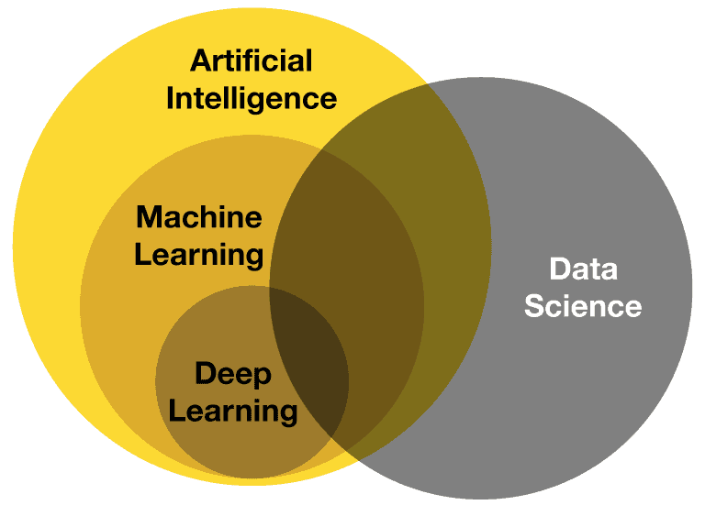
AI vs ML vs DL vs DS

Slide 4
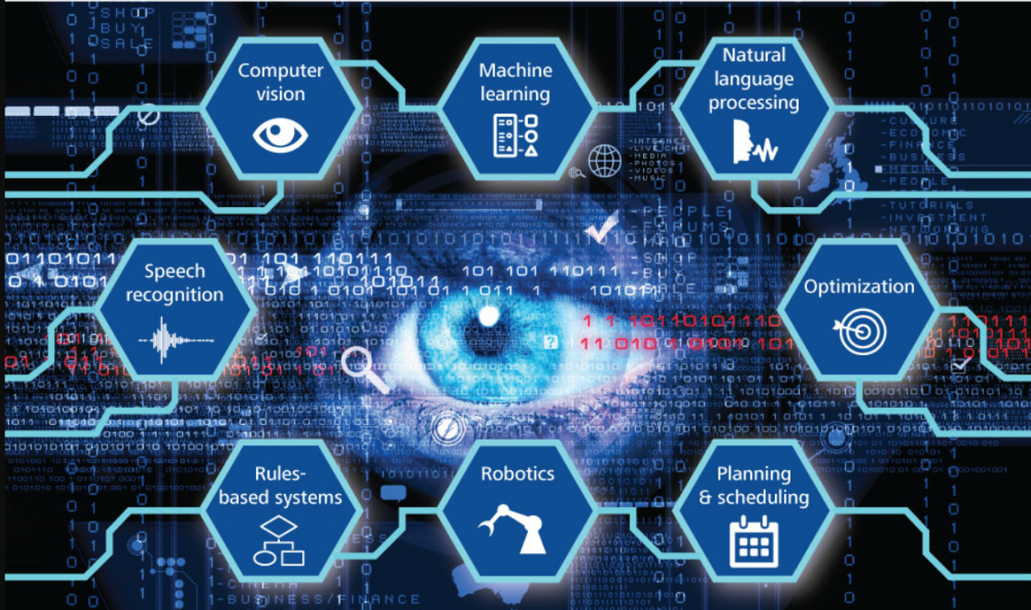
COMPONENTS OF AI

Slide 5
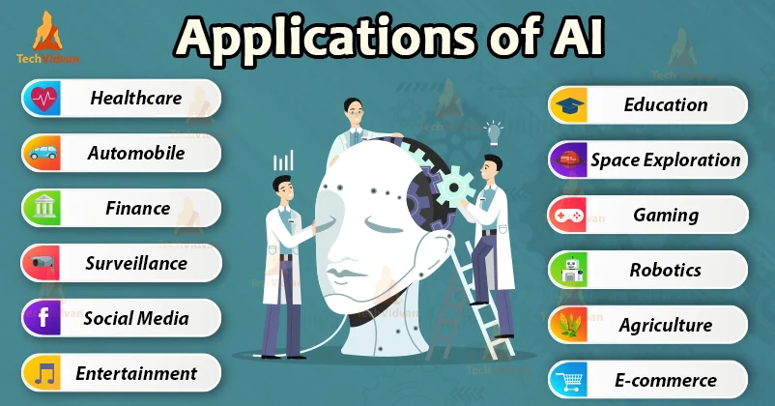
APPLICATIONS OF AI

Slide 6
WHAT IS MACHINE LEARNING
Machine learning (ML) is a type of artificial intelligence (AI) that allows software applications to become more accurate at predicting outcomes without being explicitly programmed to do so. Machine learning algorithms use historical data as input to predict new output values.

Slide 7
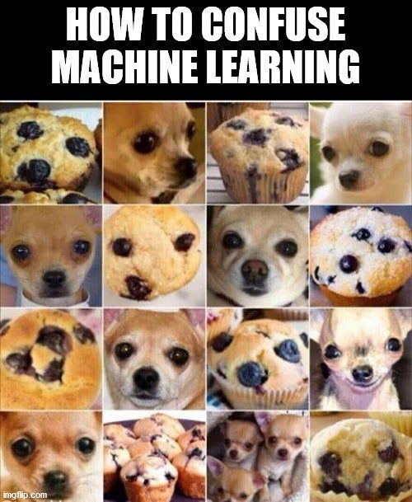

Slide 8
MODULES REQUIRED
FOR MACHINE LEARNING

Slide 9
WHY PYTHON ?!
Python facilitates developers to increase the confidence and productivity about their developing software from development to deployment and maintenance. The benefits of making Python the perfect solution for machine learning and AI-driven projects include simplicity and consistency, flexibility, access to powerful AI and machine learning (ML) libraries and frameworks, platform independence, and large communities.

Slide 10
NUMPY
NumPy is a short form for Numerical Python, which is applied for scientific programming in Python, especially for numbers. It comprises multidimensional objects in arrays and a package of integrating tools for Python implementation.

Slide 11
PANDAS
Pandas is a Python library used for working with data sets. It has functions for analyzing, cleaning, exploring, and manipulating data. Pandas allows us to analyze big data and make conclusions based on statistical theories. Pandas can clean messy data sets, and make them readable and relevant.

Slide 12
MATPLOTLIB
Matplotlib is an amazing visualization library in Python for 2D plots of arrays. Matplotlib is a multi-platform data visualization library built on NumPy arrays. One of the greatest benefits of visualization is that it allows us visual access to huge amounts of data in easily digestible visuals.

Slide 13
